Slide 1
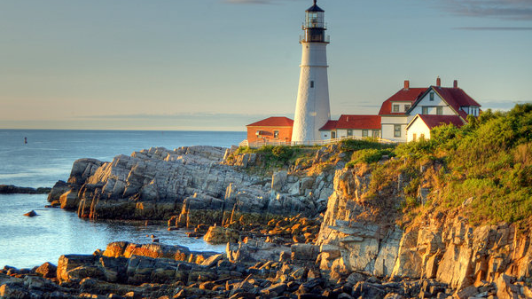
Lighthouses of New England Tours
Website Design

Slide 2
Styles
Font-family: Garamond
Colors:
Brick Red: Hex: #DF5327, RGB: 223, 83, 39
Slate Blue: Hex: #418AB3, RGB: 65, 138, 179

Slide 3
Home
Nav
Photos Section
Video Section
Contact Section

Slide 4
Home/Nav
See the Castles of New England Firsthand
Home | Photo Journey | Video Tour | Contact Us
These American castles offer breathtaking views and a taste of history.
They’re America’s castles, harboring stories of sunken ships, Revolutionary battles, desperate drownings, daring rescues, and keepers’ isolated lives. Climb up spiraling stairs and a steep ladder and through a tight hatch into the lamp room and claim your reward: a breathtaking 360-degree view. Navigation technology has rendered lighthouses mostly obsolete. Yet many mariners still look to them to negotiate New England’s rocky coastline, and they attract tourists from around the world.

Slide 5
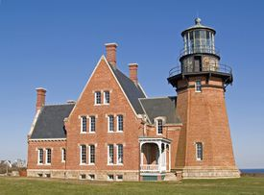
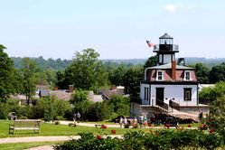
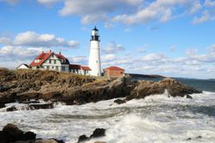
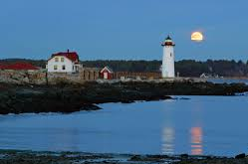
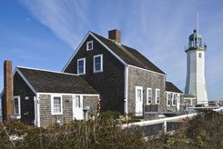
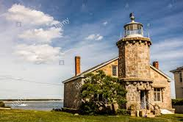
Photo Journey
Wicked cunnin' Ahcadiuh If you can't stand the wintah you don't deserve the summah Saddee, rhubaahb yahd numb, no-see-um Hammah Gohd Dammah, feeder' the beans Bangah stove .
Wicked cunnin' Ahcadiuh If you can't stand the wintah you don't deserve the summah Saddee, rhubaahb yahd numb, no-see-um Hammah Gohd Dammah, feeder' the beans Bangah stove .
Wicked cunnin' Ahcadiuh If you can't stand the wintah you don't deserve the summah Saddee, rhubaahb yahd numb, no-see-um Hammah Gohd Dammah, feeder' the beans Bangah stove .
Wicked cunnin' Ahcadiuh If you can't stand the wintah you don't deserve the summah Saddee, rhubaahb yahd numb, no-see-um Hammah Gohd Dammah, feeder' the beans Bangah stove .
Wicked cunnin' Ahcadiuh If you can't stand the wintah you don't deserve the summah Saddee, rhubaahb yahd numb, no-see-um Hammah Gohd Dammah, feeder' the beans Bangah stove .
Wicked cunnin' Ahcadiuh If you can't stand the wintah you don't deserve the summah Saddee, rhubaahb yahd numb, no-see-um Hammah Gohd Dammah, feeder' the beans Bangah stove .
©2019 Boston Globe Media Partners, LLC

Slide 6
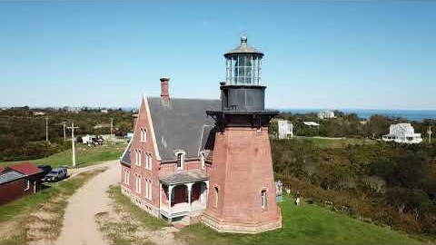
Video Flyby
New England Seashores - Lighthouses of New England
Embed code:
<iframe width="853" height="480" src="https://www.youtube.com/embed/14Ey7GBHGok" frameborder="0" allow="accelerometer; autoplay; encrypted-media; gyroscope; picture-in-picture" allowfullscreen></iframe>

Slide 7
Contact Us
Learn More About Our Epic Tours
First Name
Last Name
Street Address
City, St, Zip
Phone
Visiting when?

